Slide 1

inside jokes in plain site

Slide 2
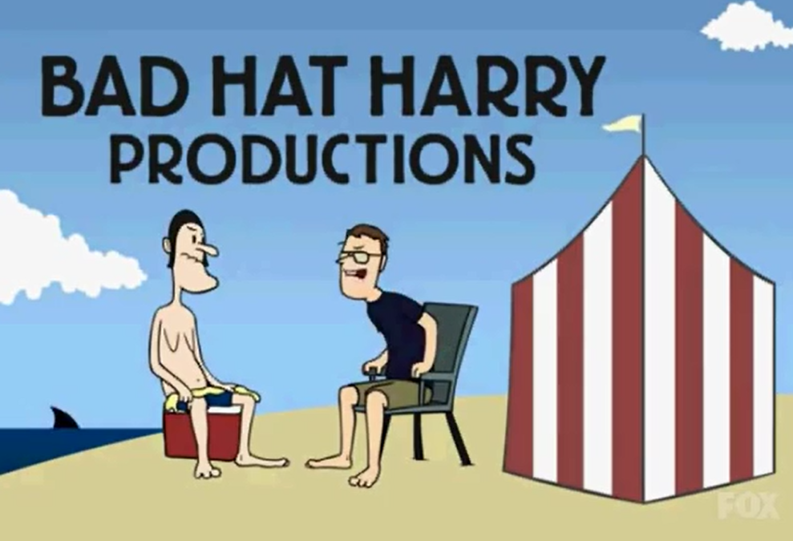
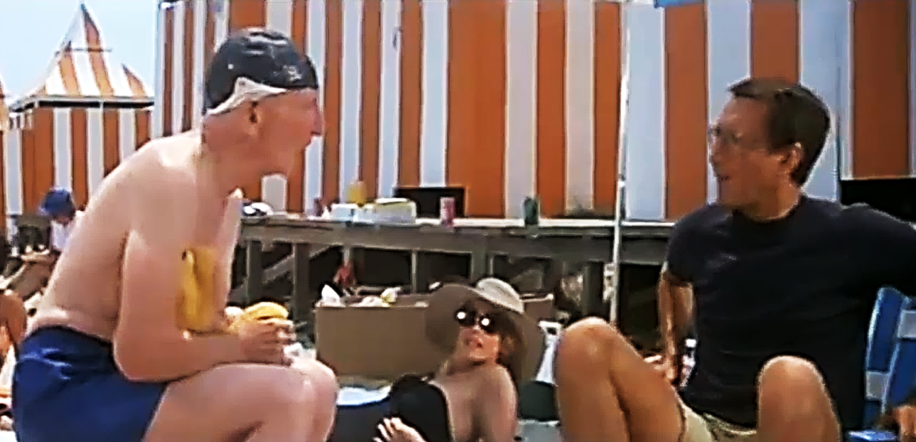
inside jokes in plain site
“some bad hat”
Bad Hat Harry Productions | Jaws

Slide 3
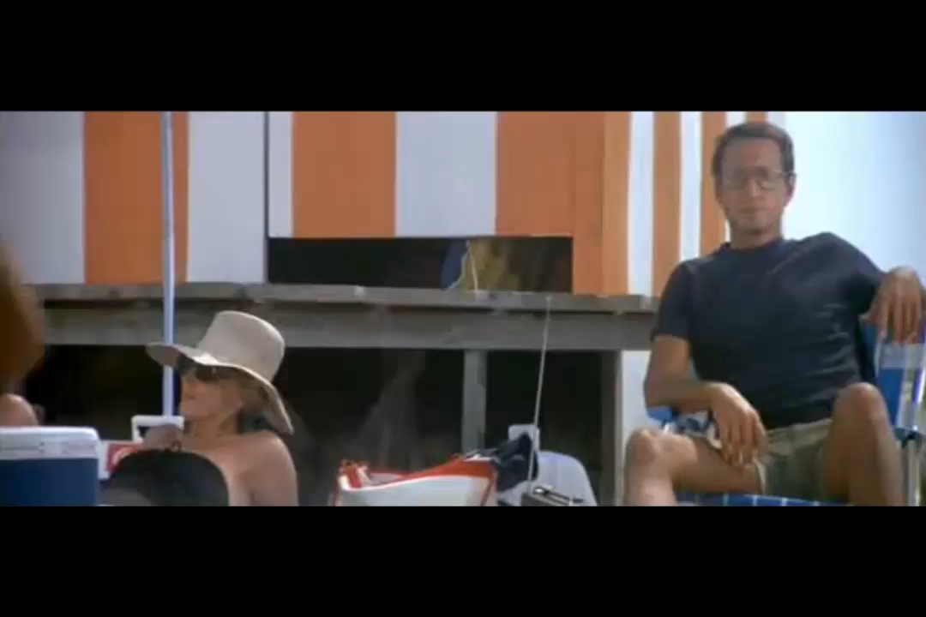


Jaws (1975)

Slide 4
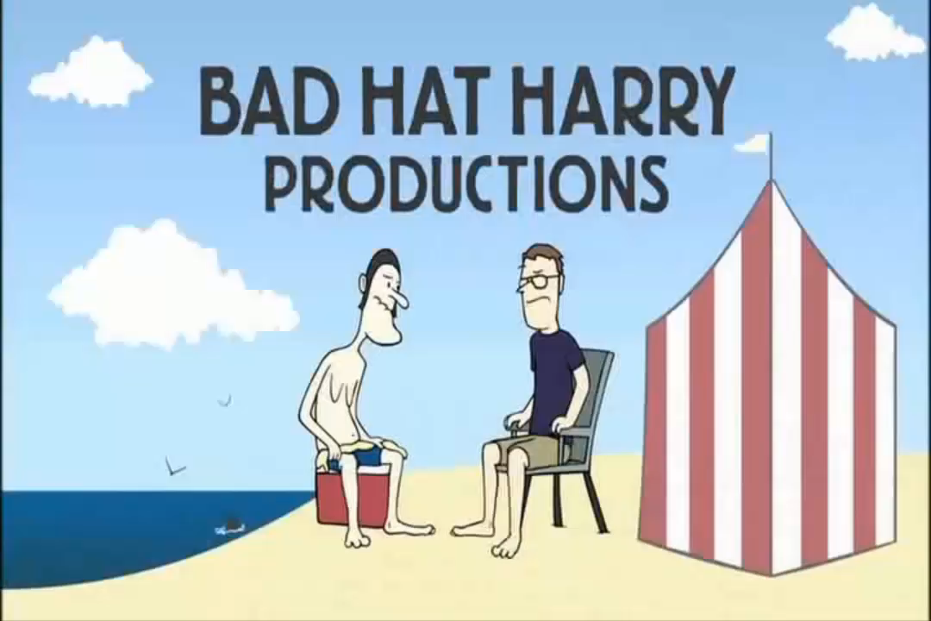

Slide 6
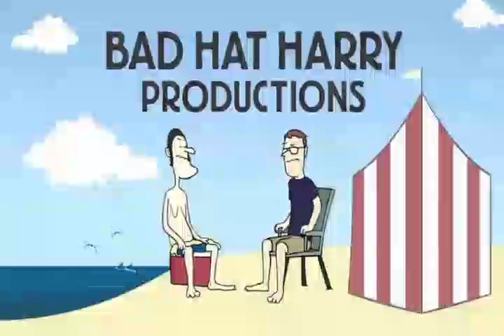


Slide 7

inside jokes in plain site
This video was created, edited, and published entirely in Microsoft PowerPoint

